Slide 1
Investigating Scatella Migration Patterns as a Potential Falsification of the Progression Rule in Phylogeography
MSA Reimplementation & Phylogenetic Tree Construction via MLE
Aaron Nagler (atn45), Aaron Song (ams799), Parker Rho (pkr47), Tony Oh (do256)
Notes:
0:00-0:20

Slide 2
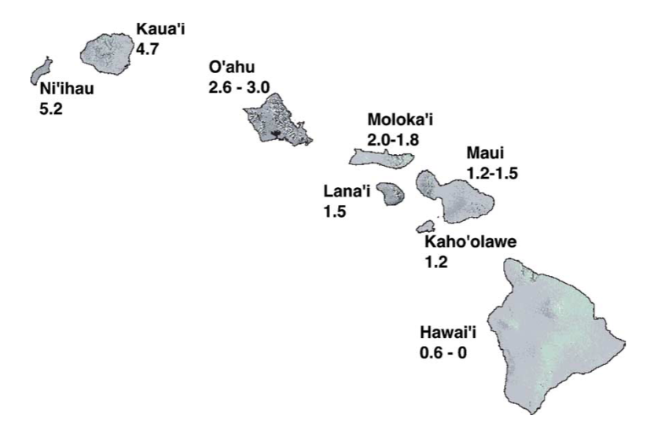
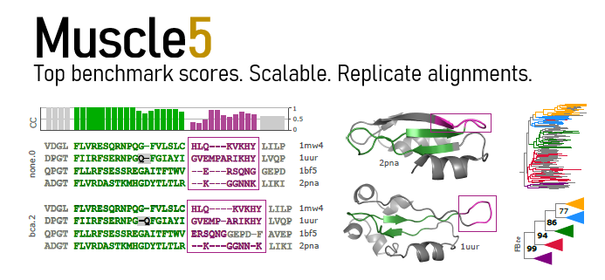
Background Information
Introduction
Methodology
Results
Discussion
Scatella in Hawaii
Phylogeography: Progression Rule
Are Scatella a potential counterexample?
MSA & MLE to determine ancestry
[1]
[2]
[1] https://www.researchgate.net/publication/7582299_Phylogeny_and_age_of_diversification_of_the_planitibia_species_group_of_the_Hawaiian_Drosophila
[2] https://drive5.com/images/muscle5_header.jpg
Notes:
0:20-1:00
Our project is looking at the Scatella species in Hawaii.
There is a current theory regarding flies in hawaiian islands called the progression rule which hypothesizes that the older fly species live on the older islands that are located farther from the hotspot
However, professor O’grady of Cornell Entomology hypothesizes that the progression rule may not hold for the scatella genus based on a phylogeny he constructed that
So our project aims to test Professor O’grady’s hypothesis by determining the ancestry of the scatella flies and their locations on the islands to see if it violates the progression rule, and these results are important because this progression rule follows a very well respected principle in the field of studying biodiversity as a whole so seeing any counterexample to this reasoning would enhance our understanding of this principle, and even if affirms the principle would reassert the validity of the rule
Why Project Is Important: The progression rule is generally accepted to be correct, and this could either reinforce its validity or cast doubt on the rule
An introduction to flies and Hawaii
Talk about why Hawaii in particular is interesting (extreme isolation)
The progression rule and why it’s interesting
Scatella and O’Grady

Slide 3

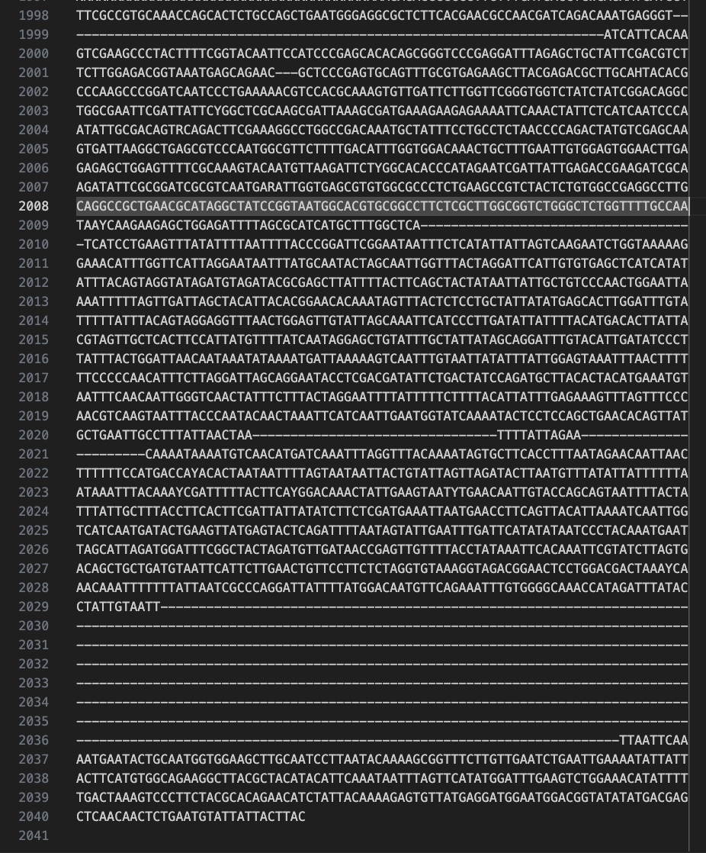
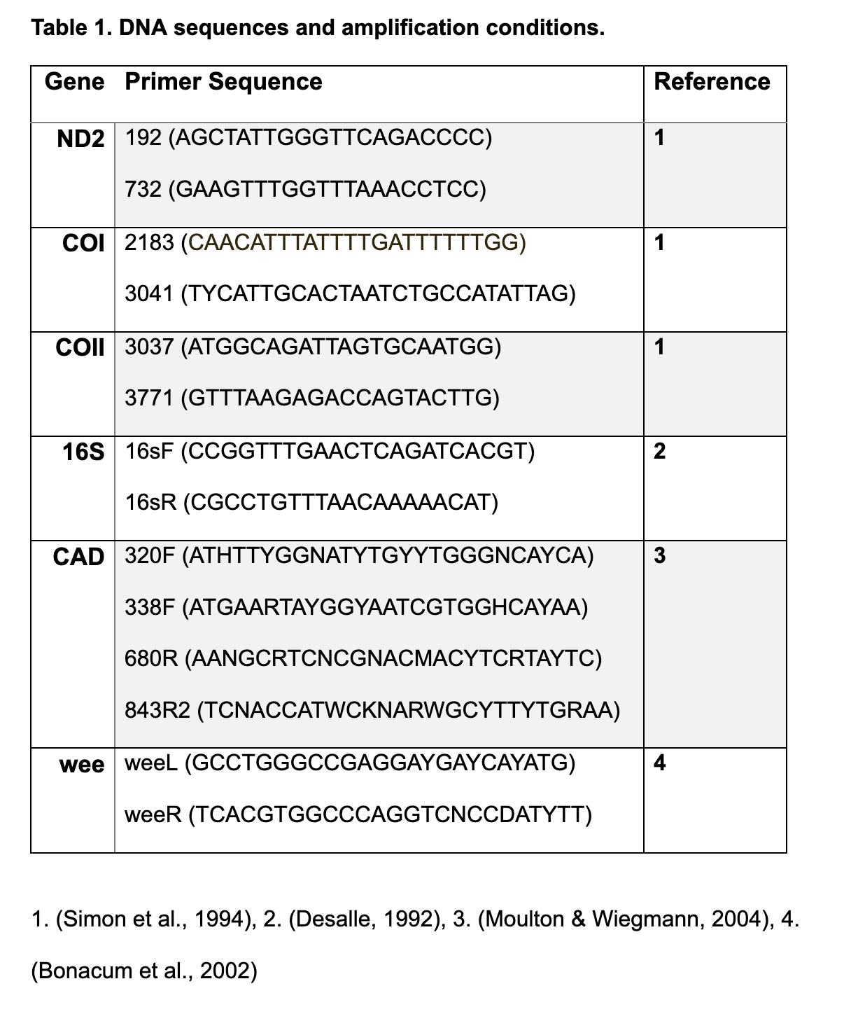
Dataset
Introduction
Methodology
Results
Discussion
Obtained from Professor Patrick O’Grady
List of DNA sequences containing 6 concatenated sequences from the CO1 gene per species of Scatella (40 different species).
[1]
[1] https://www.drosophilaevolution.com/uploads/6/6/8/3/6683664/0130-ogrady_orig.jpg
O’Grady et al., 2019
Notes:
1:00-1:20
The data we used was obtained from a professor and the chair of Cornell’s very own Entomology Department, Professor Patrick O’Grady. We received 6 concatenated sequences per species of

Slide 4

Pipeline
Introduction
Methodology
Results
Discussion
Construct Phylogeny (MLE + NNI)
MSA (MUSCLE & ClustalW)
Sequences
BioGeoBEARS (Analyze Output)
Modify Sequences
Test Hypothesis
Notes:
1:20-2:20
Run Multiple Sequence Alignment (MSA) on data
Construct phylogeny using MSA
Input phylogeny into BioGeoBears
Analyze output for BioGeoBears to test hypothesis

Slide 5
MSA: Progressive Algorithm (ClustalW)
Introduction
Methodology
Results
Discussion
Pros
Fast
Effective for close sequences
Cons
No convergence guarantee
Cascading errors
“Once a gap, always a gap”
Compute Pairwise Similarity (Needleman-Wunsch)
Build Guide Tree (Neighbor Joining)
Progressive Alignment (DP & Profile Alignment)
Notes:
2:20-2:40

Slide 6

MSA: Iterative Algorithm (MUSCLE)
Introduction
Methodology
Results
Discussion
Pros
High accuracy and speed
Cons
Limitations in handling complex alignments with large insertions/deletions
Compute Distance matrix (k-mer Similarity)
Build Guide Tree (UPGMA)
Progressive Alignment (Split and Realign)
Notes:
2:40-3:00
UPGMA: Unweighted Pair Group Method with Arithmetic Mean

Slide 7
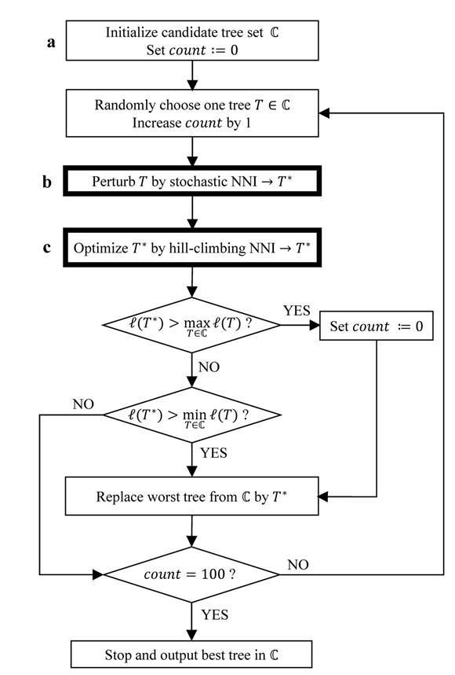
Building Trees: MLE + NNI (IQ-TREE)
Introduction
Methodology
Results
Discussion
Make distance matrix, O(n²s)
Initialize an unrooted tree with NJ, O(n³)
Maximum Likelihood Branch Length Optimization, O(ns)
Hill Climbing NNI, O(pns) where p is the number of refinement stages (shown to be asymptotically less than n)
Nguyen et al., 2015
Notes:
3:00-3:30

Slide 8
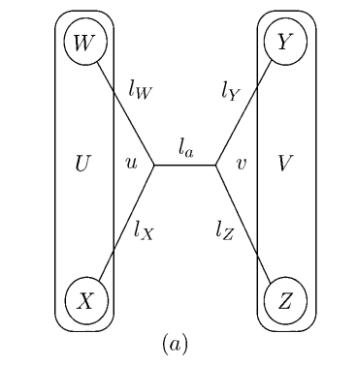
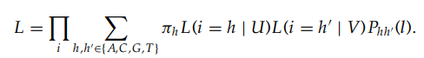
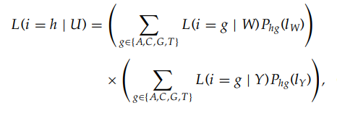
ML Branch Length Optimization
Introduction
Methodology
Results
Discussion
Equation 1:
Equation 2:
Guindon et al., 2003
Notes:
3:30-4:00

Slide 9

Hill-Climbing NNI
Introduction
Methodology
Results
Discussion
NNI: Nearest Neighbor Interchange
Hill-Climbing:
Create a NNI-neighborhood of trees that strictly increase the computed ML branch length optimization
Remove NNIs with “conflicting branches”
Apply all NNIs from the neighborhood to the current tree and choose the tree with the best likelihood
Repeat to get the best tree ever :D (the locally optimal tree)
Nguyen et al., 2015
Notes:
4:00-4:30

Slide 10
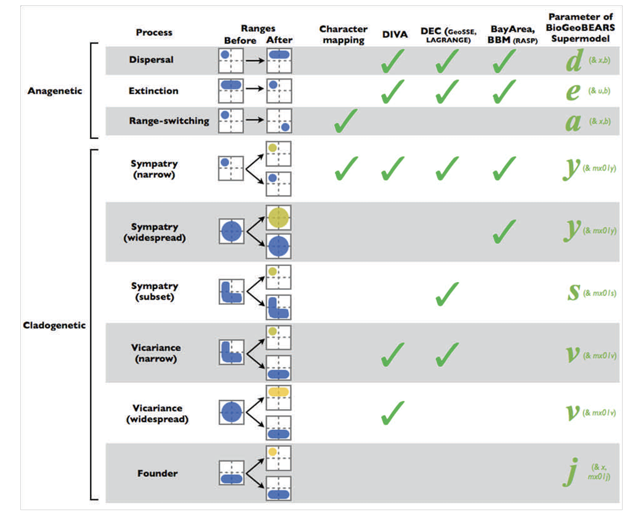
BioGeoBEARS (Matzke et al., 2013)
Introduction
Methodology
Results
Discussion
R Package to test our phylogeny
Included Parameters:
Dispersal
Extinction
Range-switching
Various Indications of Sympatry and Vicariance
Matzke et al., 2013
Notes:
4:30-5:00
Input: our phylogenetic tree, location data of Hawaii
Output: various parameters that indicate validity of our phylogenetic tree
Can determine the probability of dispersal between regions, and time‐stratification, where different dispersal matrices exist as geography changes over geological time.

Slide 11
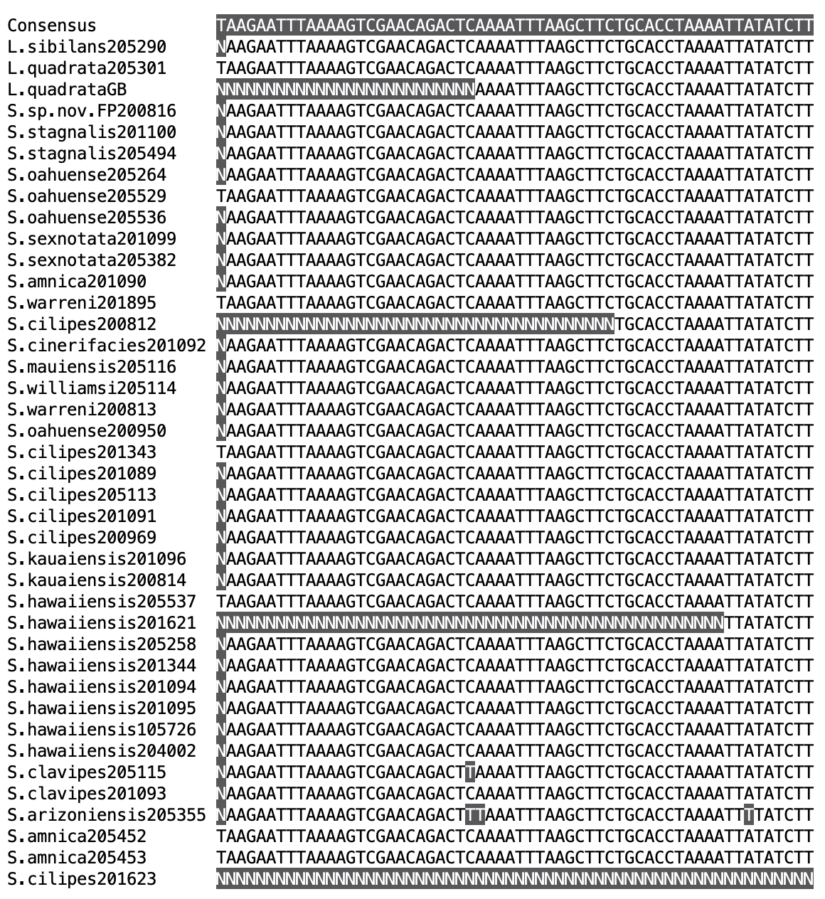
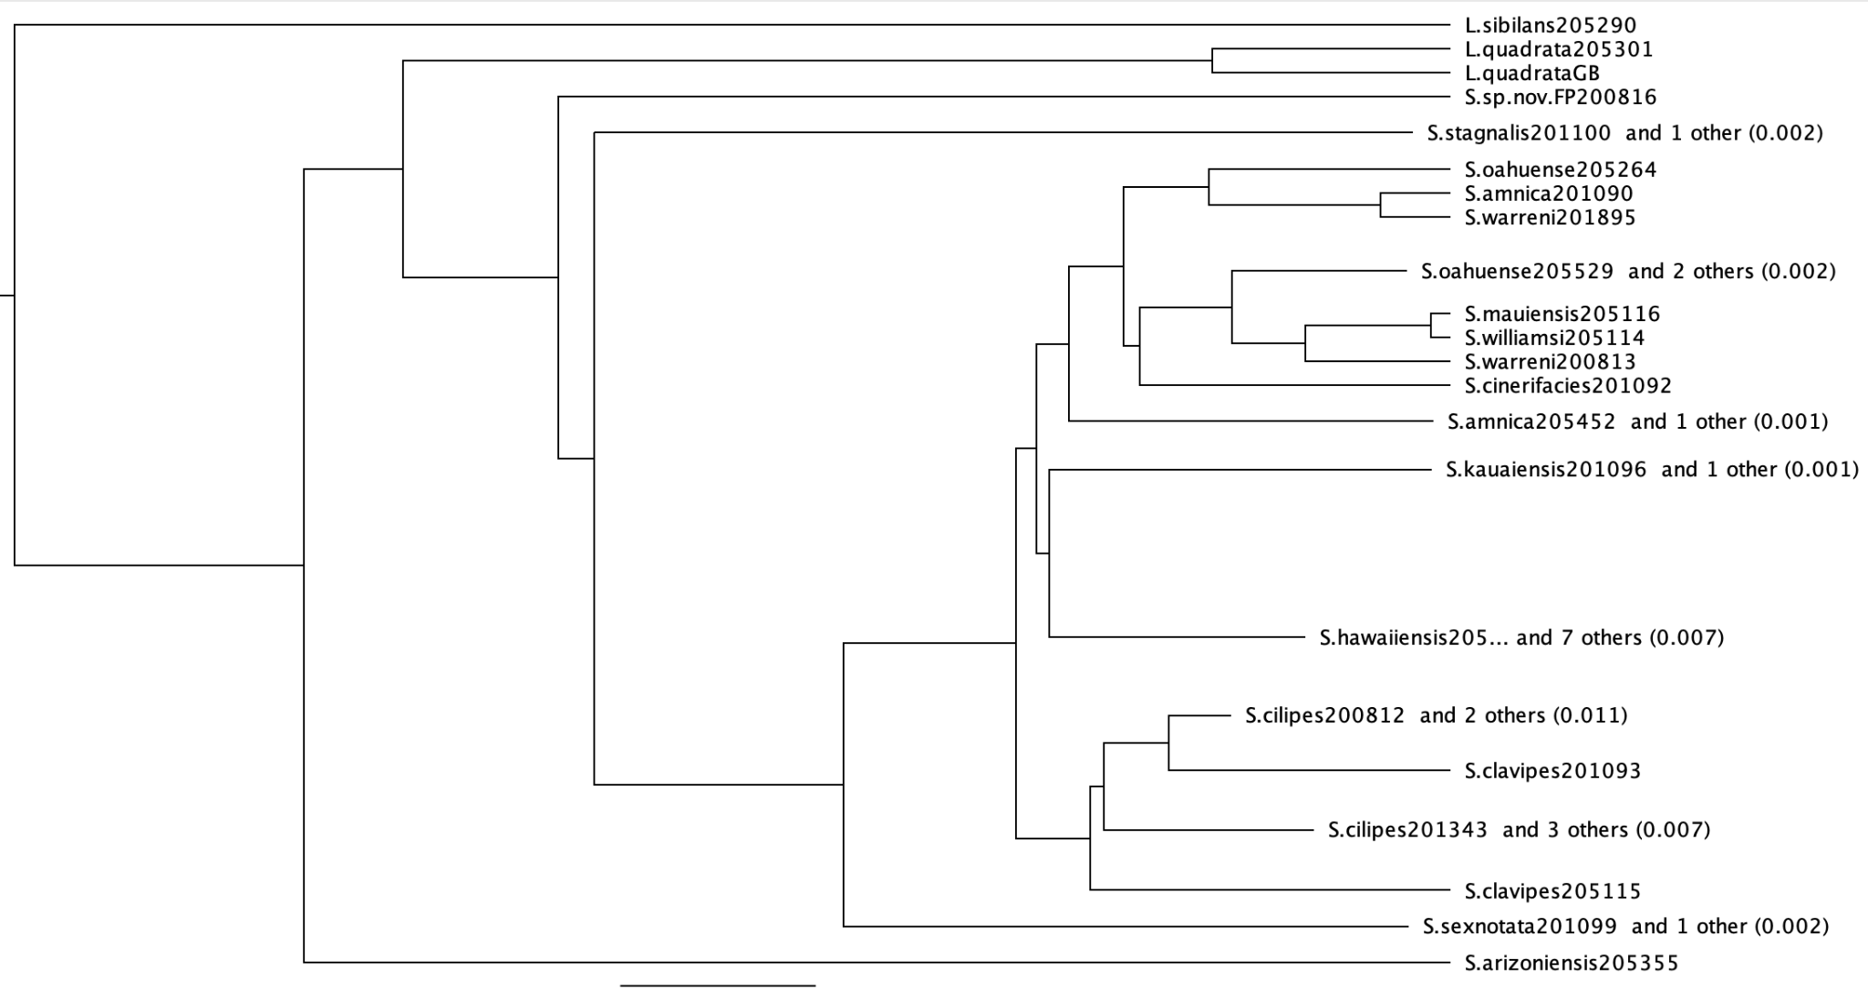
Preliminary Results
Introduction
Methodology
Results
Discussion
Constructed MSA using MUSCLE
Constructed phylogenetic tree using UPGMA
Geneious Prime 2025.0.3
Notes:
5:00-5:30
Software called Geneious that performs computations that we need to construct MSA and tree
Currently waiting for location data of Hawaii to run BioGeoBEARS

Slide 12


Limitations and Remaining Work
Introduction
Methodology
Results
Discussion
Trim sequences to minimize gaps
Too many gaps
Continue reimplementation of MUSCLE and MLE + NNI
Analyze our phylogenies using BioGeoBEARS
Notes:
5:30-6:00

Slide 13
Resources
Introduction
Methodology
Results
Discussion
ML Branch Length Optimization and Hill-Climbing NNI: Stéphane Guindon, Olivier Gascuel, A Simple, Fast, and Accurate Algorithm to Estimate Large Phylogenies by Maximum Likelihood, Systematic Biology, Volume 52, Issue 5, 1 October 2003, Pages 696–704, https://doi.org/10.1080/10635150390235520
BioGeoBears: Matzke, N. J. (2013). Probabilistic historical biogeography: new models for founder-event speciation, imperfect detection, and fossils allow improved accuracy and model-testing. Frontiers of Biogeography, 5(4). http://dx.doi.org/10.21425/F5FBG19694 Retrieved from https://escholarship.org/uc/item/44j7n141
IQ-Tree: Lam-Tung Nguyen, Heiko A. Schmidt, Arndt von Haeseler, Bui Quang Minh, IQ-TREE: A Fast and Effective Stochastic Algorithm for Estimating Maximum-Likelihood Phylogenies, Molecular Biology and Evolution, Volume 32, Issue 1, January 2015, Pages 268–274, https://doi.org/10.1093/molbev/msu300
Supplementary images of supporting Scatella were created with the assistance of DALL-E 2

Slide 14
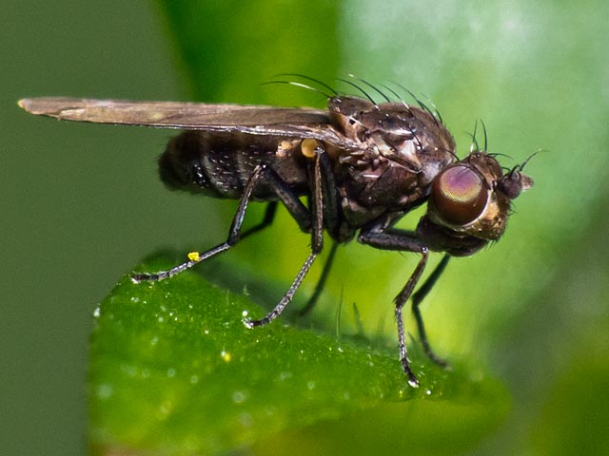


Thank You :3
[1]
[1] https://tasmanianinsectfieldguide.com/hexapoda/insectsoftasmaniadiptera/suborder-brachycera/infraorder-cyclorrhapha/ephdridae-marsh-shore-flies/genus-scatella/scatella-scatella-nitidithorax/

